Slide 1

Apache Airflow
Iuliia Volkova, xnuinside@gmail.com

Slide 2
Agenda (Day 1)
What is Apache Airflow?
What is Workflow Manager (orchestrator) and what is ETL
Server Components & basic installation, cli
DAG, basic DAG params & DAGFile, Tasks
DAG Run & Task Instance
Operators, Sensors
Schedule interval & catch up & execution date
Junja2 Templating,
Task Statuses
Files to play with (homework)
Q&A session
CONFIDENTIAL | © 2019 EPAM Systems, Inc.

Slide 3
Agenda (Day 2)
Macros, User Defined Marcos, Xcom
SLAs, Alerts, Retries
BranchOperator, TriggerRules
Hooks, Connections
Executors
Configuration (let’s add Celery Executor & PostgreSQL)
Workers & Flower
Variables, Run DAG with Params
Backfill
Customization: UI plugins
Airflow in clouds: Google Compose (Airflow in GCP), Astronomer.io
Q&A session
CONFIDENTIAL | © 2019 EPAM Systems, Inc.
© 2020 EPAM Systems, Inc.

Slide 4
What is Apache Airflow?

Slide 5
What is Apache Airflow?
It is an workflow manager!
(or orchestrator)

Slide 6
What is workflow or pipeline or DAG (Direct Acyclic Graph)
Task 1
Task 2
Task 3
…
Do this
When do this
End etc.

Slide 7







Alternatives (Orchestrators)
For DS & ML
CONFIDENTIAL | © 2019 EPAM Systems, Inc.
© 2020 EPAM Systems, Inc.

Slide 8





Similar things for Ops/DevOps/non data workflows
and etc.

Slide 9
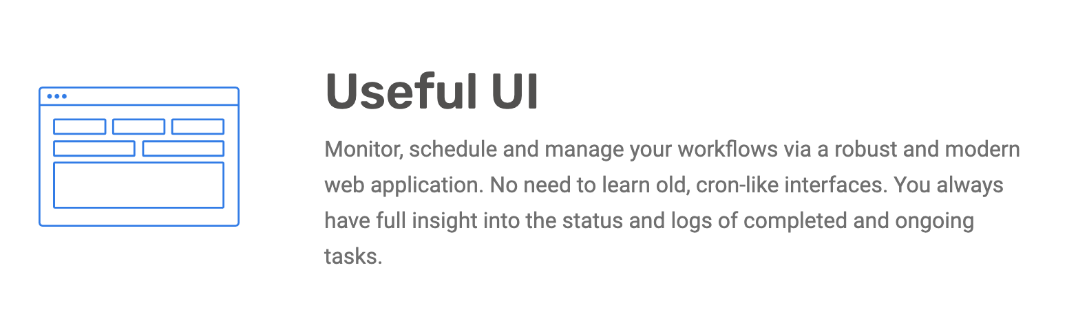
Main Features

Slide 10
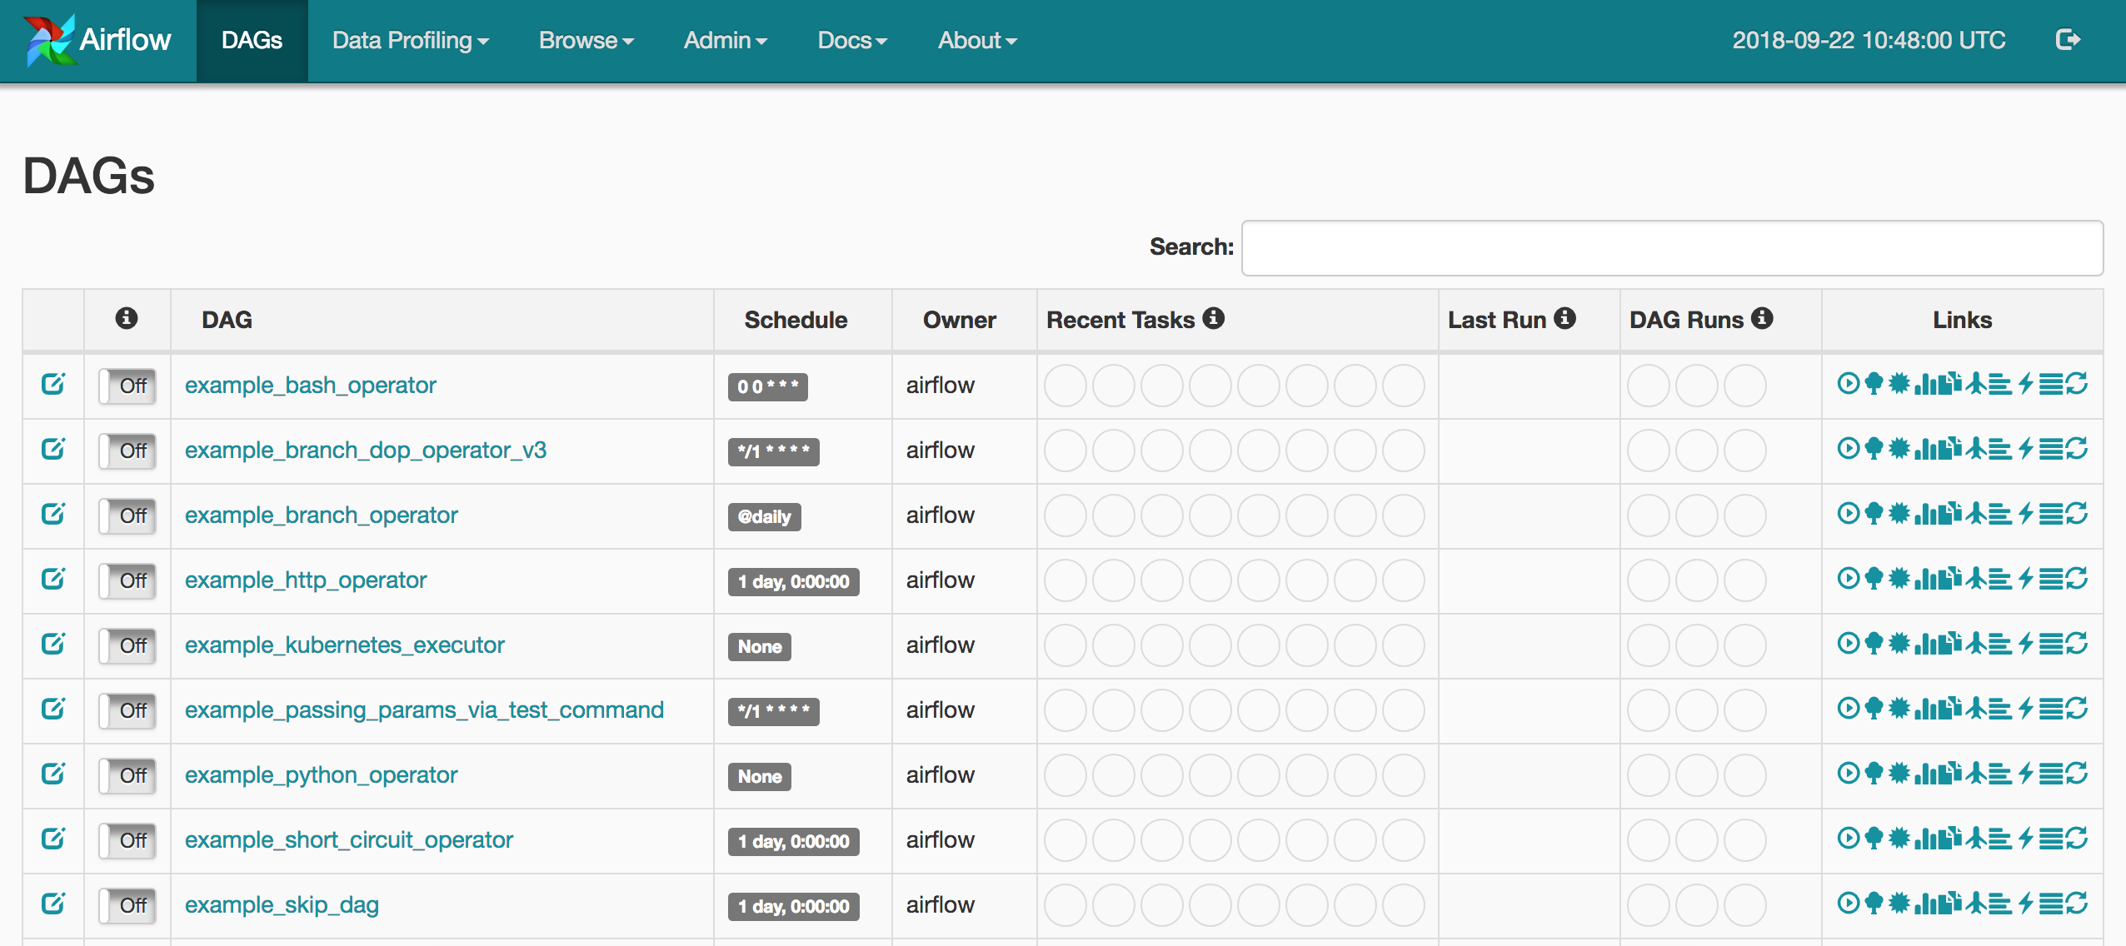
UI Screens – DAGs List

Slide 11
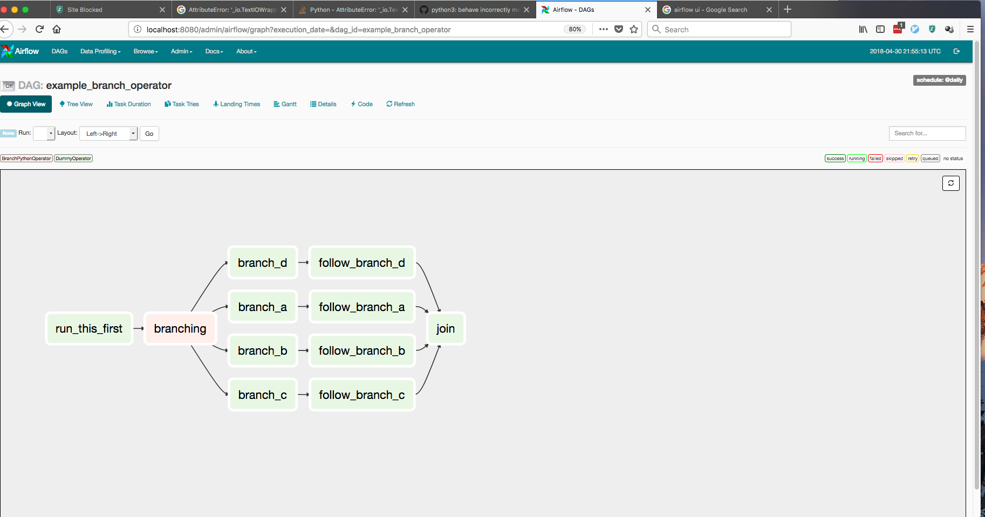
UI Screens – DAGs View

Slide 12
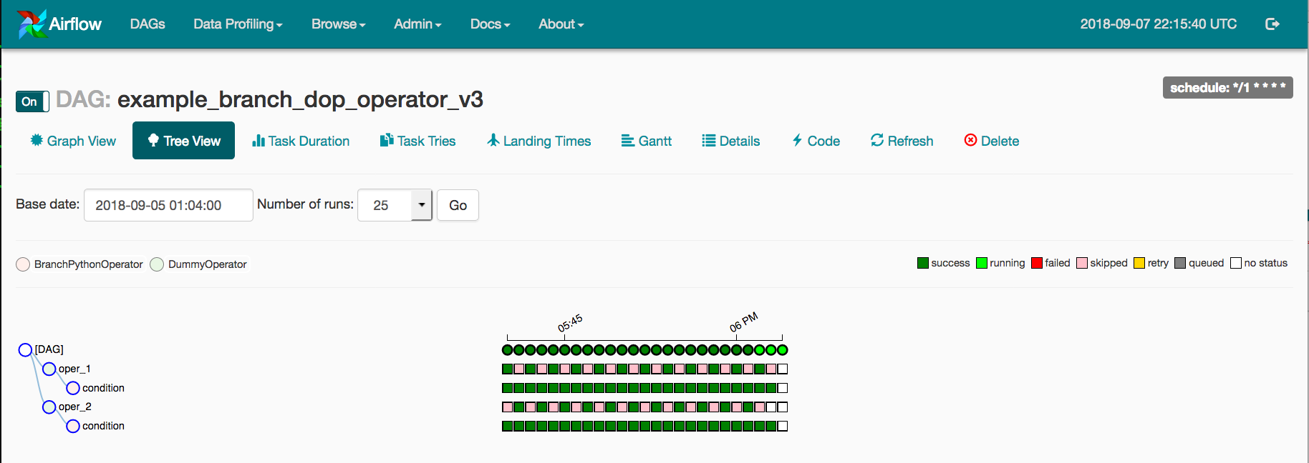
UI Screens – DAGs Runs, Tree View
CONFIDENTIAL | © 2019 EPAM Systems, Inc.

Slide 13
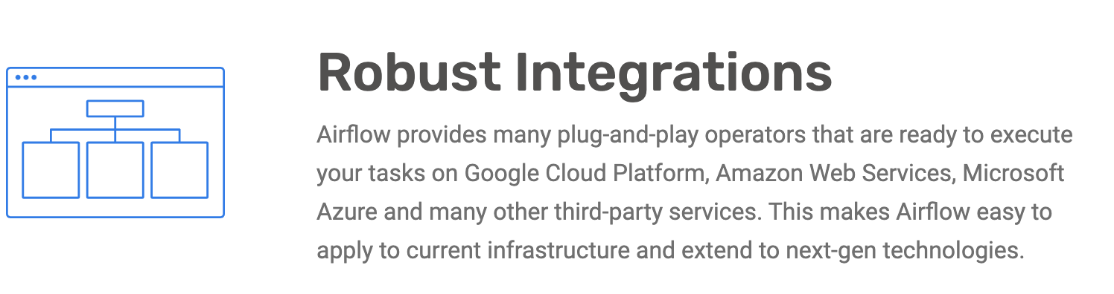
Main Features
CONFIDENTIAL | © 2019 EPAM Systems, Inc.
© 2020 EPAM Systems, Inc.

Slide 14










Main Features
Integrations from the box (Operators, Sensors, Connectors & Hooks)
https://airflow.apache.org/docs/apache-airflow/stable/_api/airflow/operators/index.html
https://airflow.apache.org/docs/apache-airflow/stable/_api/airflow/contrib/operators/
CONFIDENTIAL | © 2019 EPAM Systems, Inc.
© 2020 EPAM Systems, Inc.
And OTHERs

Slide 15
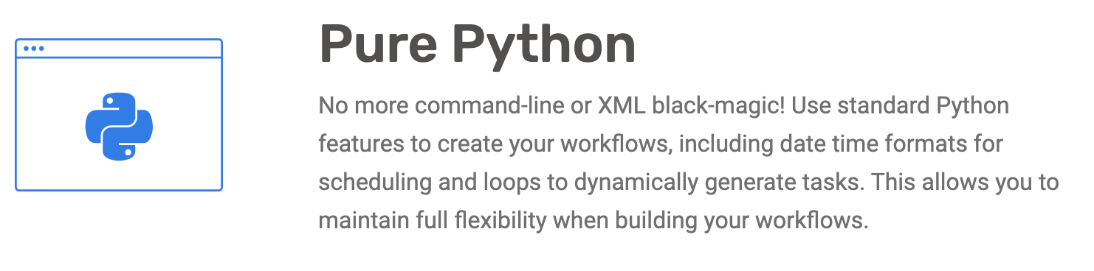
Main Features

Slide 16
DAG Code Example
import uuid from datetime import datetime from airflow import DAG from airflow.utils.trigger_rule import TriggerRule from airflow.operators.postgres_operator import PostgresOperator dag_params = { 'dag_id': 'PostgresOperator_dag', 'start_date': datetime(2019, 10, 7), 'schedule_interval': None } with DAG(**dag_params) as dag: create_table = PostgresOperator( task_id='create_table', sql='''CREATE TABLE new_table( custom_id integer NOT NULL, timestamp TIMESTAMP NOT NULL, user_id VARCHAR (50) NOT NULL );''', ) insert_row = PostgresOperator( task_id='insert_row', sql='INSERT INTO new_table VALUES(%s, %s, %s)', trigger_rule=TriggerRule.ALL_DONE, parameters=(uuid.uuid4().int % 123456789, datetime.now(), uuid.uuid4().hex[:10]) ) create_table >> insert_row
CONFIDENTIAL | © 2019 EPAM Systems, Inc.
© 2020 EPAM Systems, Inc.

Slide 17
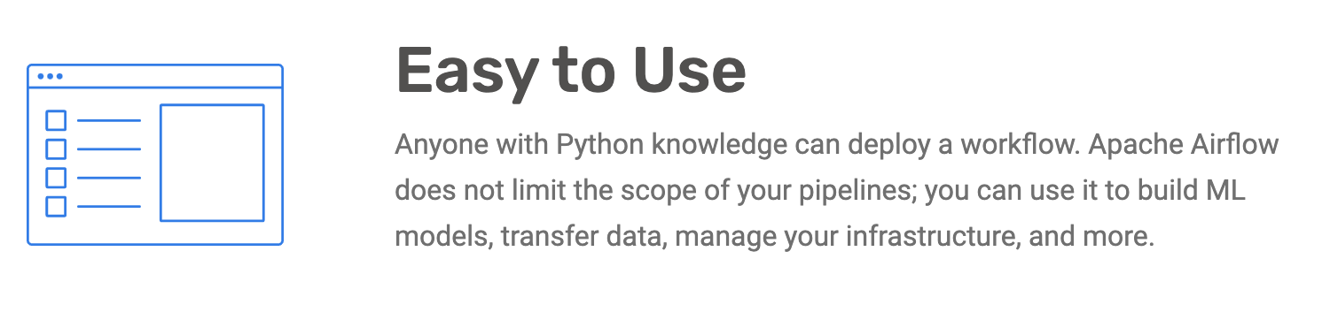
Main Features
CONFIDENTIAL | © 2019 EPAM Systems, Inc.
© 2020 EPAM Systems, Inc.

Slide 18
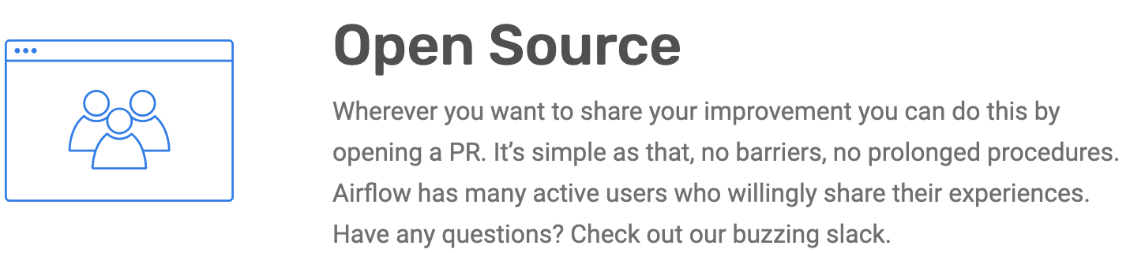
Main Features
CONFIDENTIAL | © 2019 EPAM Systems, Inc.
© 2020 EPAM Systems, Inc.

Slide 19
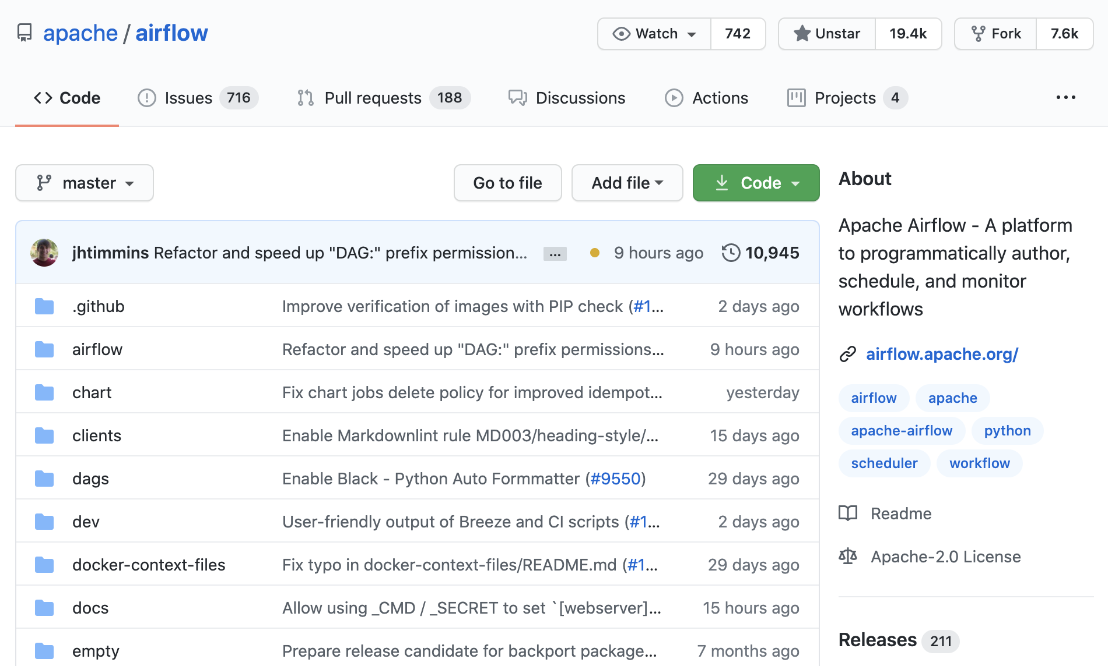
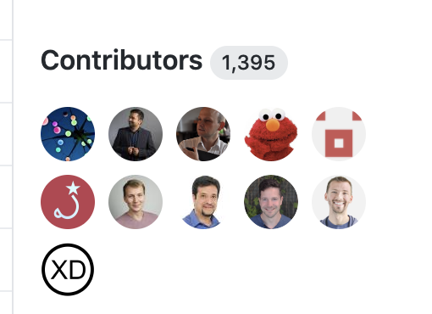
Apache Airflow Community
https://github.com/apache/airflow
Official community Slack:
https://apache-airflow-slack.herokuapp.com/
List of committers (maintainers):
https://people.apache.org/committers-by-project.html#airflow (about 40 people)
CONFIDENTIAL | © 2019 EPAM Systems, Inc.
© 2020 EPAM Systems, Inc.

Slide 20
What is a workflow manager?
(or orchestrator)
CONFIDENTIAL | © 2019 EPAM Systems, Inc.
© 2020 EPAM Systems, Inc.

Slide 21
Data Flow
Data
© 2020 EPAM Systems, Inc.
21

Slide 22







Data Flow
Data Lakes
Data
Databases
22

Slide 23







Data Flow
Data Warehouses
Data Lakes
Any Custom Actions/ Transformations
Data
Databases
CONFIDENTIAL | © 2019 EPAM Systems, Inc.
© 2020 EPAM Systems, Inc.
23

Slide 24


Data Flow
Data Warehouses
Data Lakes
Any Custom Actions/ Transformations
Data
Databases
Data Processing Jobs
24

Slide 25


Data Flow
Data Warehouses
Data Lakes
Any Custom Actions/ Transformations
Output to Any
Systems / Custom Services
Data
Databases
Data Processing Jobs
25

Slide 26
Orchestrator or Workflow manager
Allows you to create Data Pipelines
& describe all steps of your Data Flow:
from where to where, what, when and how
– multiple task in any sequence (not only classical ETL)
26

Slide 27
Extract, transform, load
Extract
Transform
Load
Data Lakes
Any Custom Actions/ Transformations
Data Warehouses
Output to Any
Systems / Custom Services
Databases
Data Processing Jobs
CONFIDENTIAL | © 2019 EPAM Systems, Inc.
27
© 2020 EPAM Systems, Inc.

Slide 28
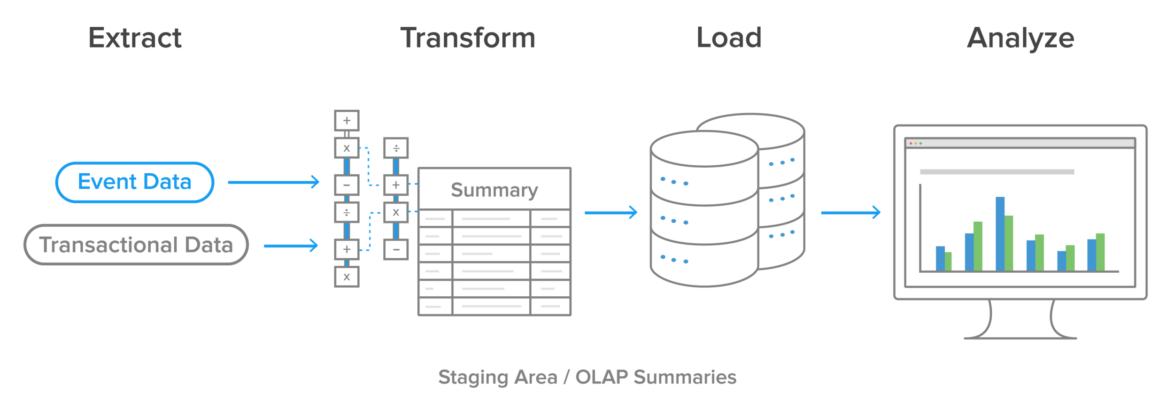
Workflow Capabilities that we needs
1. Monitoring Dashboard (what’s going on with our pipeline?)
2. Alerts (if something wrong
– I must know about it quick)
3. SLAs (if we don’t have data for the day
– do we have the problem?)
4. Way to make customization
And etc.
CONFIDENTIAL | © 2019 EPAM Systems, Inc.
28
© 2020 EPAM Systems, Inc.

Slide 29
Pipeline Example in Words
Let’s imagine. We work in Data Engineering Team in The Stationery Shop (pens, papers and etc). We have about 1500 offline shops, online shop and direct sales.
We work on the Data Pipeline that assume information about our clients from different sources.
29

Slide 30



Pipeline Example in Words
Let’s imagine. We work in Data Engineering Team in The Stationery Shop (pens, papers and etc). We have about 1500 offline shops, online shop and direct sales.
We work on the Data Pipeline that assume information about our clients from different sources.
clients
CustomersData
clients
clients
CONFIDENTIAL | © 2019 EPAM Systems, Inc.
30
© 2020 EPAM Systems, Inc.

Slide 31
Pipeline Example in Words
Let’s imagine. We work in Data Engineering Team in The Stationery Shop (pens, papers and etc). We have about 1500 offline shops, online shop and direct sales.
We work on the Data Pipeline that assume information about our clients from different sources.
1. Is it a new client?
2. What we already know
about this client?
3. Try to map client by some ‘ criteria’ based on already existed information
4. Update Data (Data Changed in Timeline – orders, marketing activities …)
… etc
clients
CustomersData
clients
clients
31

Slide 32


Pipeline – find the client by credit card number
32

Slide 33
Pipeline – find the client by credit card number
Find the client by card information
Is it a new client?
33

Slide 34
Pipeline – find the client by credit card number
Create new Client & insert Orders Information
Find the client by card information
no
CustomersData
Is it a new client?
CONFIDENTIAL | © 2019 EPAM Systems, Inc.
34
© 2020 EPAM Systems, Inc.

Slide 35
Pipeline – find the client by credit card number
Create new Client & insert Orders Information
Find the client by card information
no
CustomersData
Is it a new client?
yes
Update Orders Information
35

Slide 36
Pipeline – find the client by credit card number
POS Machine
Reports in XML
/${shop_id}/${current_date}/${hour}/${uuid_name}${pos_id}.xml
…
Parse file:
Extract data
Update customer
Table: customers
CustomersData
Create new customer
Table:
orders
Table:
shops
CONFIDENTIAL | © 2019 EPAM Systems, Inc.
36
© 2020 EPAM Systems, Inc.

Slide 37
Abstract visualization
Task 4
Create new customer
Task 1
Task 2
Task 3
Get new data
Parse file
Check if
customer in DB
Task 5
Update existed
CONFIDENTIAL | © 2019 EPAM Systems, Inc.
37
© 2020 EPAM Systems, Inc.

Slide 38
Congratulations!
We just described a Workflow or a Pipeline…
38

Slide 39
Or DAG – main concept
of Apache Airflow
© 2020 EPAM Systems, Inc.
39

Slide 40
Some key characteristic of Pipelines
Schedule: They run in time with different schedule, duration, etc
Triggers: Pipelines can have Triggers that cause need to run the pipeline
Fails: Pipelines can fail. We need 1) to know about it 2) to get possible start it from failed place – and this is why you task must be atomic and small
Re-processing: Sometimes you need reprocess data for whole long periods in past
Sometimes fails can be because of network or system issues and you want to have auto retries
40

Slide 41
Before we will create our first DAG –
let’s up & run Apache Airflow Server
CONFIDENTIAL | © 2019 EPAM Systems, Inc.
41
© 2020 EPAM Systems, Inc.

Slide 42
Disclaimer:
all information relative to Apache Airflow
actual on version 1.10.12 and can be different on ver 2.0+
42

Slide 43
High-level overview of Apache Airflow components
UI
WebServer
REST API (experimental since v1.8)
43

Slide 44
High-level overview of Apache Airflow components
Cli
Control
UI
run servers,
run dags, add params and etc
WebServer
REST API (experimental since v1.7)
44

Slide 45
CLI
https://airflow.apache.org/docs/apache-airflow/stable/cli-ref
Server commands:
airflow initdb
airflow webserver
airflow scheduler and etc.
45

Slide 46
High-level overview of Apache Airflow components
Cli
Control
UI
run servers,
run dags, add params and etc
WebServer
REST API (experimental since v1.7)
Decide what to run
Scheduler
46

Slide 47
High-level overview of Apache Airflow components
Cli
Control
UI
run servers,
run dags, add params and etc
WebServer
REST API (experimental since v1.7)
Execute tasks
Decide what to run
Scheduler
Executor
CONFIDENTIAL | © 2019 EPAM Systems, Inc.
47
© 2020 EPAM Systems, Inc.

Slide 48
High-level overview of Apache Airflow components
Cli
Control
UI
run servers,
run dags, add params and etc
WebServer
REST API (experimental since v1.7)
$AIRFLOW_HOME/dags
Execute tasks
Decide what to run
Scheduler
Executor
48

Slide 49
High-level overview of Apache Airflow components
Cli
Control
UI
run servers,
run dags, add params and etc
WebServer
REST API (experimental since v1.7)
$AIRFLOW_HOME/dags
Metadata DB
Execute tasks
Decide what to run
Scheduler
Executor
CONFIDENTIAL | © 2019 EPAM Systems, Inc.
49
© 2020 EPAM Systems, Inc.

Slide 50
Process of DAG execution
Scheduler
Metadata DB
Get information about Paused/Unpaused -> Schedule + params - > Dependencies/Statuses
Check folder each
‘scheduler_heartbeat_sec=‘ sec
(by default 5 )
$AIRFLOW_HOME/dags
CONFIDENTIAL | © 2019 EPAM Systems, Inc.
50
© 2020 EPAM Systems, Inc.

Slide 51
Process of DAG execution
Scheduler
Metadata DB
Get information about Paused/Unpaused -> Schedule + params - > Dependencies/Statuses
Task can be run
Check folder each
‘scheduler_heartbeat_sec=‘ sec
(by default 5 )
Get execution status (failed, success, running)
Executor
$AIRFLOW_HOME/dags
51

Slide 52
High-level overview of Apache Airflow components
Cli
Control
UI
If you work with CeleryExecutor
run servers,
run dags, add params and etc
WebServer
Worker
Celery Worker
REST API (experimental since v1.7)
$AIRFLOW_HOME/dags
Metadata DB
Monitor for CeleryWorkers
Execute tasks
Flower
Decide what to run
Scheduler
Executor
52

Slide 53
High-level overview of Apache Airflow components
Cli
Control
UI
If you work with CeleryExecutor
run servers,
run dags, add params and etc
WebServer
(Flask + Gunicorn)
Worker
Celery Worker
REST API (experimental since v1.7)
SQLAlchemy
.../dags
Metadata DB
Monitor for CeleryWorkers
Execute tasks
Flower
Decide what to run
Scheduler
Executor
53

Slide 54
Quick Start
https://airflow.apache.org/docs/stable/start.html#quick-start
# install from pypi using pip
pip install apache-airflow
# initialize the database (create all needed tables)
airflow initdb
# start the web server, default port is 8080
airflow webserver -p 8080
# start the scheduler
airflow scheduler
# airflow needs a home, ~/airflow is the default, # but you can lay foundation somewhere else if you prefer # (optional)
export AIRFLOW_HOME=~/airflow
54

Slide 55
Errors
In November 2020 after install apache-airflow==1.10.12 if you will try to run ‘airflow initdb’ you will get an error:
from attr import fields, resolve_types
ImportError: cannot import name 'resolve_types' from 'attr’
To solve it you need install cattrs==1.1.0:
$ pip install cattrs==1.1.0
CONFIDENTIAL | © 2019 EPAM Systems, Inc.
55
© 2020 EPAM Systems, Inc.

Slide 56
Remove DAG examples
1. Set in config option “load_examples = False“ before airflow initdb
If you already did ‘airflow initdb’ and want to remove example DAGs
Set in config option “load_examples = False“
Run “airflow resetdb”
56

Slide 57
Airflow by default
executor = SequentialExecutor
sql_alchemy_conn = sqlite:////Users/iuliia_volkova2/airflow/airflow.db – only 1 connection
Extra packages in Installation:
https://airflow.apache.org/docs/apache-airflow/stable/installation.html#extra-packages
57

Slide 58
Let’s define our first DAG
Create a DAGFile in $AIRFLOW_HOME/dags directory
DAGFile – file with .py that contains words ‘airflow’ and ‘DAG’
If you don’t want Apache Airflow to parse your files:
add it to .airflowignore in DAGs folder
58

Slide 59
Let’s define our first DAG
from datetime import datetime from airflow import DAG from airflow.operators.dummy_operator import DummyOperator with DAG( dag_id="consume_new_data_from_pos", start_date=datetime(2020, 12, 1), schedule_interval=None ) as dag:
dag_id – unique dag_id (dag name)
start_date – date from that we start process the date
schedule_interval – schedule how we plan to run DAG (daily, hourly and etc)
59

Slide 60
Let’s define our first DAG
from datetime import datetime from airflow import DAG from airflow.operators.dummy_operator import DummyOperator with DAG( dag_id="consume_new_data_from_pos", start_date=datetime(2020, 12, 1), schedule_interval=None ) as dag:
dag_id – unique dag_id (dag name)
start_date – date from that we start process the date
schedule_interval – schedule how we plan to run DAG (daily, hourly and etc)
© 2020 EPAM Systems, Inc.
60

Slide 61
Add tasks to the DAG
from datetime import datetime from airflow import DAG from airflow.operators.dummy_operator import DummyOperator with DAG( dag_id="consume_new_data_from_pos", start_date=datetime(2020, 12, 1), schedule_interval=None ) as dag:
get_new_data = DummyOperator(task_id="get_new_data")
parse_file = DummyOperator(task_id="parse_file")
task_id – unique task_id, mandatory to all Operators
DummyOperator – operator that does nothing (useful to prototype pipeline)
CONFIDENTIAL | © 2019 EPAM Systems, Inc.
61
© 2020 EPAM Systems, Inc.

Slide 62
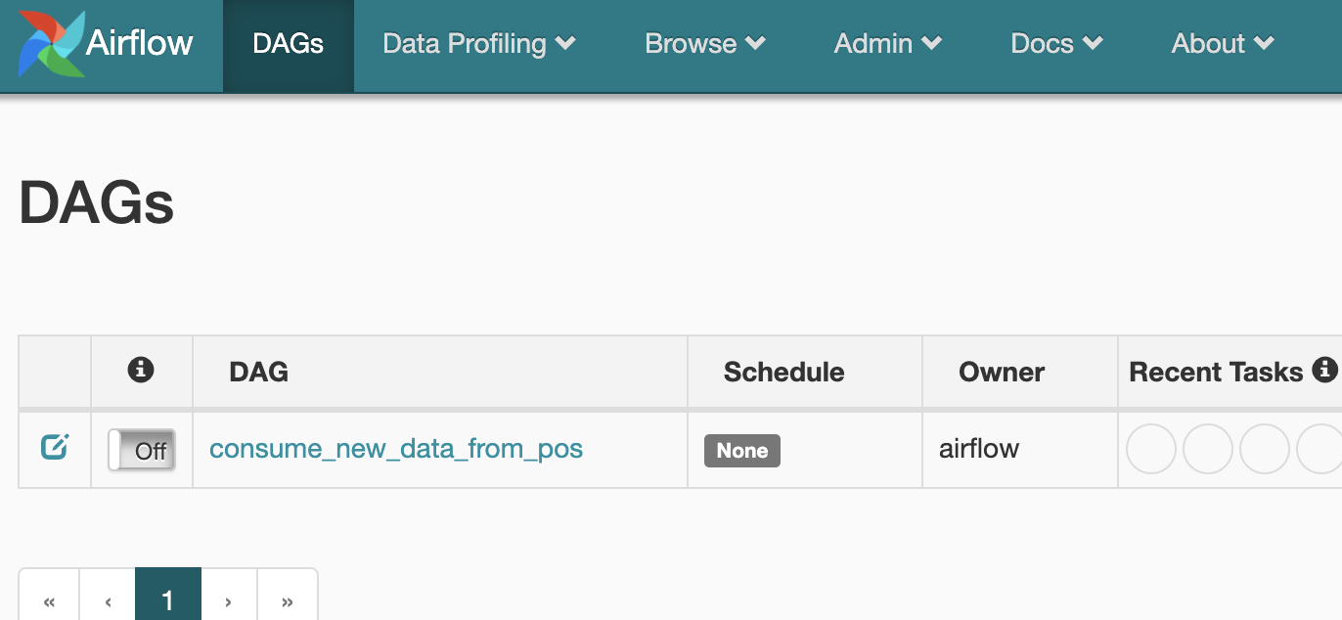
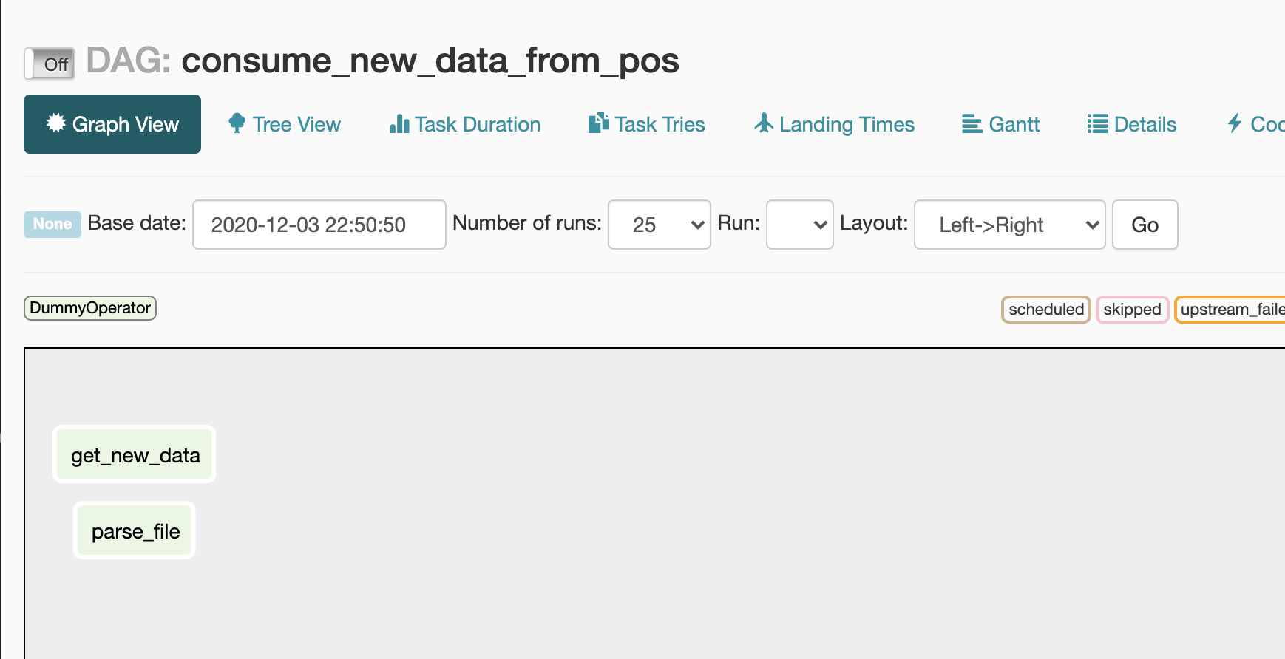
Let’s check the UI
62

Slide 63
Define a sequence of tasks
from datetime import datetime from airflow import DAG from airflow.operators.dummy_operator import DummyOperator with DAG( dag_id="consume_new_data_from_pos", start_date=datetime(2020, 12, 1), schedule_interval=None ) as dag:
get_new_data = DummyOperator(task_id="get_new_data")
parse_file = DummyOperator(task_id="parse_file")
get_new_data >> parse_file
set_downstream >>
set_upstream <<
CONFIDENTIAL | © 2019 EPAM Systems, Inc.
63
© 2020 EPAM Systems, Inc.

Slide 64
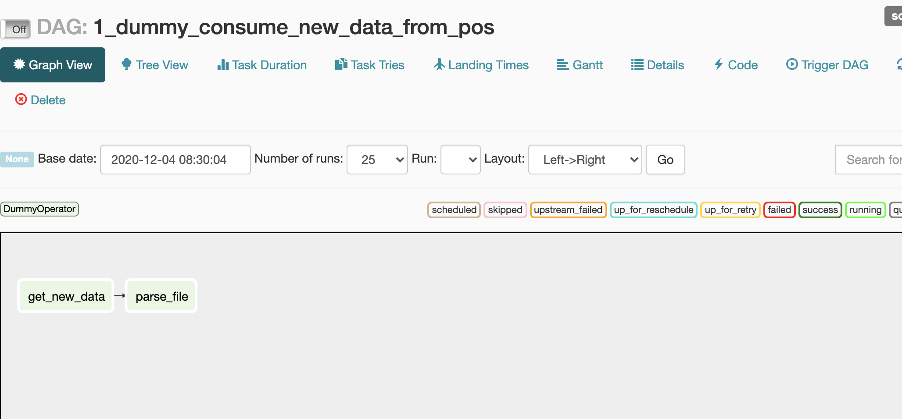
Define a sequence of tasks
64

Slide 65
Define a sequence of tasks
[task1, task2, task3] >> task4 - allowed
task4 >> [task1, task2, task3] – allowed
task5 >> [task1, task2, task3]
[task1, task2, task3] >> [task4, task5] – not allowed
[task4, task5] >> [task1, task2, task3] – not allowed
unsupported operand type(s) for >>: 'list' and 'list'
© 2020 EPAM Systems, Inc.
65

Slide 66
Let’s define the full DAG
from datetime import datetime from airflow import DAG from airflow.operators.dummy_operator import DummyOperator with DAG( dag_id="consume_new_data_from_pos", start_date=datetime(2020, 12, 1), schedule_interval=None ) as dag: get_new_data = DummyOperator(task_id="get_new_data")
parse_file = DummyOperator(task_id="parse_file")
check_is_it_ne_customer = DummyOperator(task_id="check_is_it_ne_customer")
create_new_customer = DummyOperator(task_id="create_new_customer")
update_existed_customer = DummyOperator(task_id="update_existed_customer")
get_new_data >> parse_file >> check_is_it_ne_customer >> [create_new_customer, update_existed_customer]
66

Slide 67
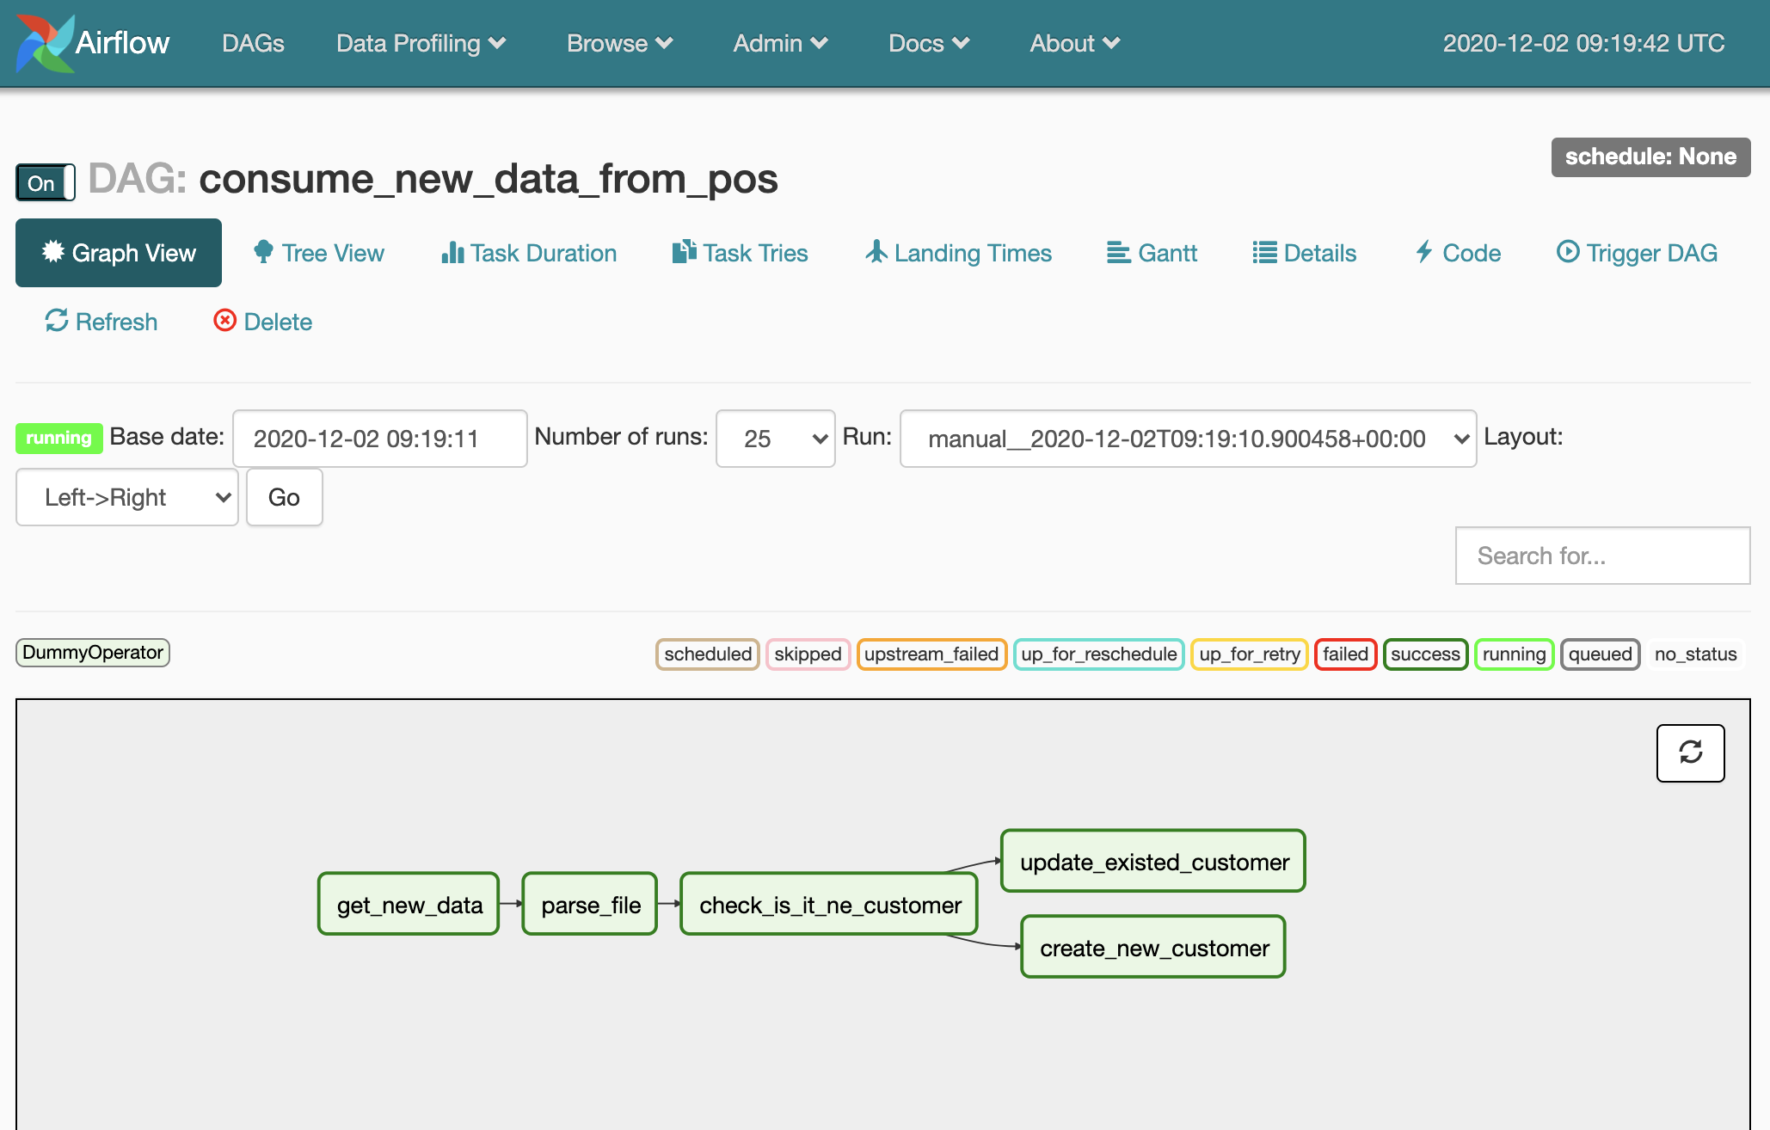
Apache Airflow UI
67

Slide 68
DAG – Directed Acyclic Graph
Task 4
Create new customer
Task 1
Task 2
Task 3
Get new data
Parse file
Check if
customer in DB
Task 5
Update existed
CONFIDENTIAL | © 2019 EPAM Systems, Inc.
68
© 2020 EPAM Systems, Inc.

Slide 69
What can be a Task?
Operators
Sensors
Just DO right now
– report about completion
Poke(wait) condition
until try
69

Slide 70
What can be a Task?
Operators
Sensors
Just DO right now
– report about completion
Poke(wait) condition
until try
Examples:
FileToGoogleCloudStorageOperator
MySqlOperator
AWSAthenaOperator
…
Examples:
HdfsSensor
HttpSensor
SqlSensor
…
CONFIDENTIAL | © 2019 EPAM Systems, Inc.
70
© 2020 EPAM Systems, Inc.

Slide 71
Moment of Task Completion
Run Spark Job
- run as background process
- By ssh in another server
- By REST
(Task is ‘success’ after
send a command to run job)
– Run as a java command
in current server, wait until it finish
(Task in ‘running’
status until complete)
71

Slide 72
What can be a Task?
BaseOperator
Operators
BaseSensorOperator
execute()
Sensors
Functional logic, what task must do in pipeline
poke()
72

Slide 73
Let’s define our primitive Operator
from typing import Union, Iterable, Dict from airflow.models import BaseOperator, SkipMixin class HelloOperator(BaseOperator, SkipMixin): def execute(self, context): self.logger.info("Hello, World!")
And put module with it to $AIRFLOW_HOME/dags directory
Airflow add $AIRFLOW_HOME/dags to PYTHONPATH
so everything inside it you can use with import
73

Slide 74
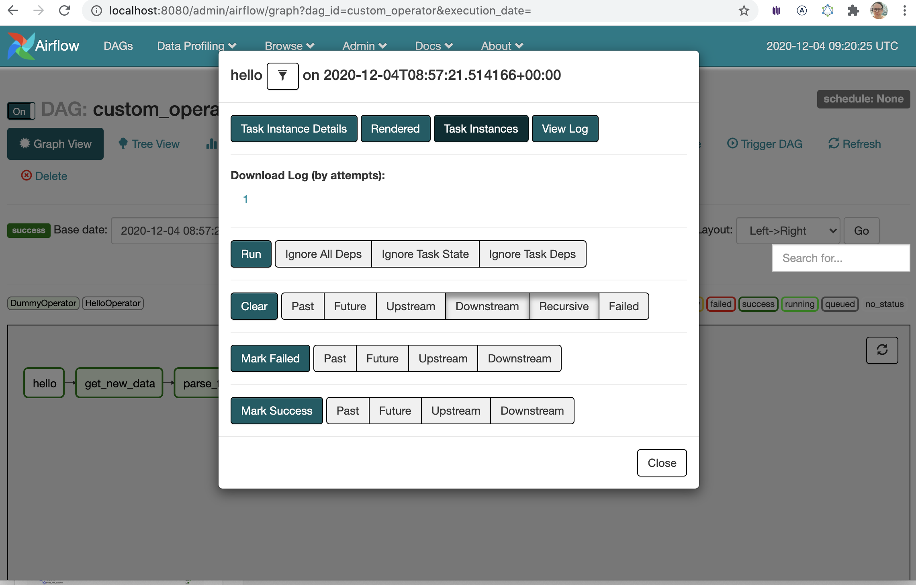
Check the UI that all works good
74

Slide 75
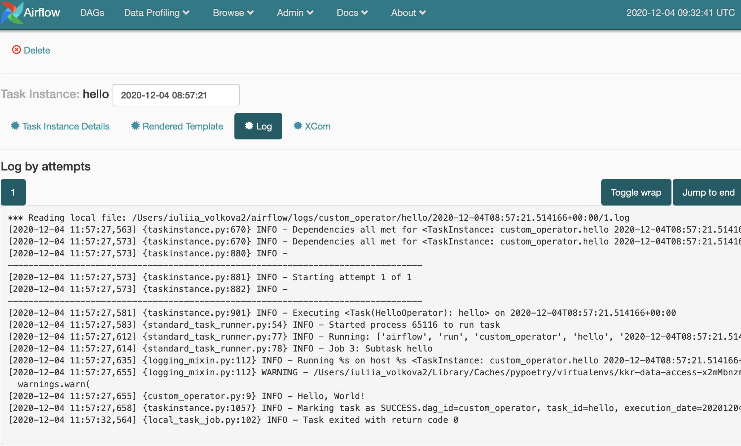
Check the UI that all works good
CONFIDENTIAL | © 2019 EPAM Systems, Inc.
75
© 2020 EPAM Systems, Inc.

Slide 76
Check the UI that all works good
76

Slide 77
Let’s play with Tasks menu
Task Details
Task logs
Task clean up / change status
Let’s check Browse menu also
77

Slide 78
What we already saw in Airflow
Server components
How to define DAG with minimal params
How to define tasks
What is Operator & Sensors
How to define custom Operator
Tasks Details & Logs in UI
Browse menu in UI
78

Slide 79
Dynamical DAGs generation: DAGFile & multiple DAGs in one file
DAGFile != DAG
… def create_dag( ... ) -> DAG: … # build a dag for each number in range(10) for n in range(1, 10): dag_id = 'hello_world_{}'.format(str(n)) params = {'dag_id': dag_id, 'schedule_interval': None, 'start_date': datetime(2020, 12, 1)} dag_number = n globals()[dag_id] = create_dag(dag_number, params)
CONFIDENTIAL | © 2019 EPAM Systems, Inc.
79
© 2020 EPAM Systems, Inc.

Slide 80
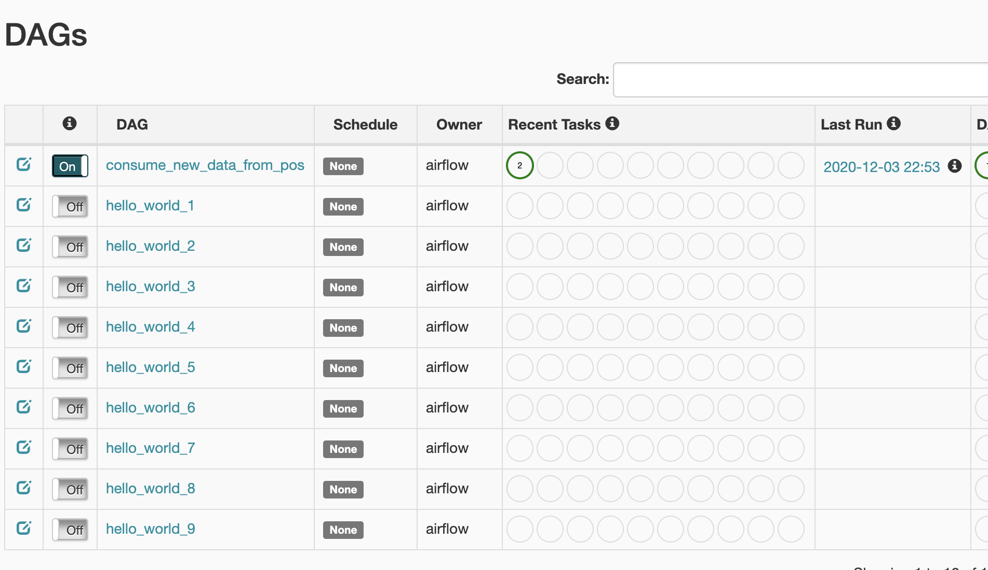
DAGFile & multiple DAGs in one file
… def create_dag( ... ) -> DAG: … # build a dag for each number in range(10) for n in range(1, 10): dag_id = 'hello_world_{}'.format(str(n)) params = {'owner': 'airflow', 'start_date': datetime(2020, 12, 1)} dag_number = n globals()[dag_id] = create_dag(dag_id, dag_number, params)
80

Slide 81
Dynamical DAGs generation: read properties from yaml or JSON
Simple read & parse with Pure Python code – custom config/DAG readers
Existed third-party libraries/solutions, for example:
https://github.com/rambler-digital-solutions/airflow-declarative
81

Slide 82
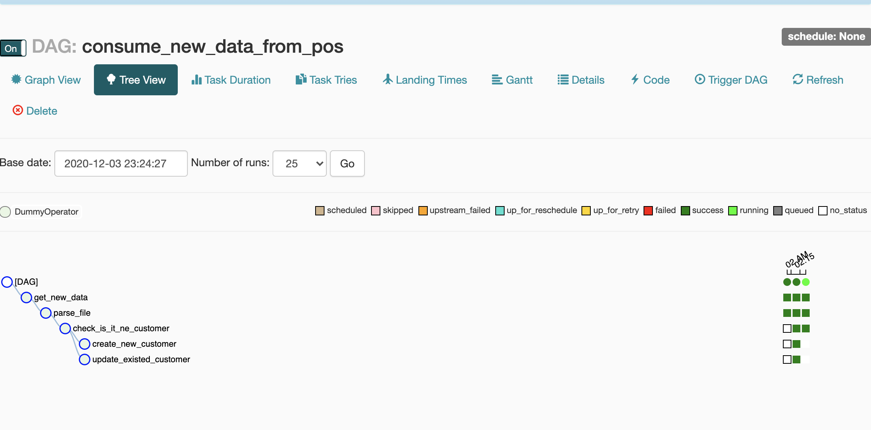
DAG Runs & Task Instances
82

Slide 83
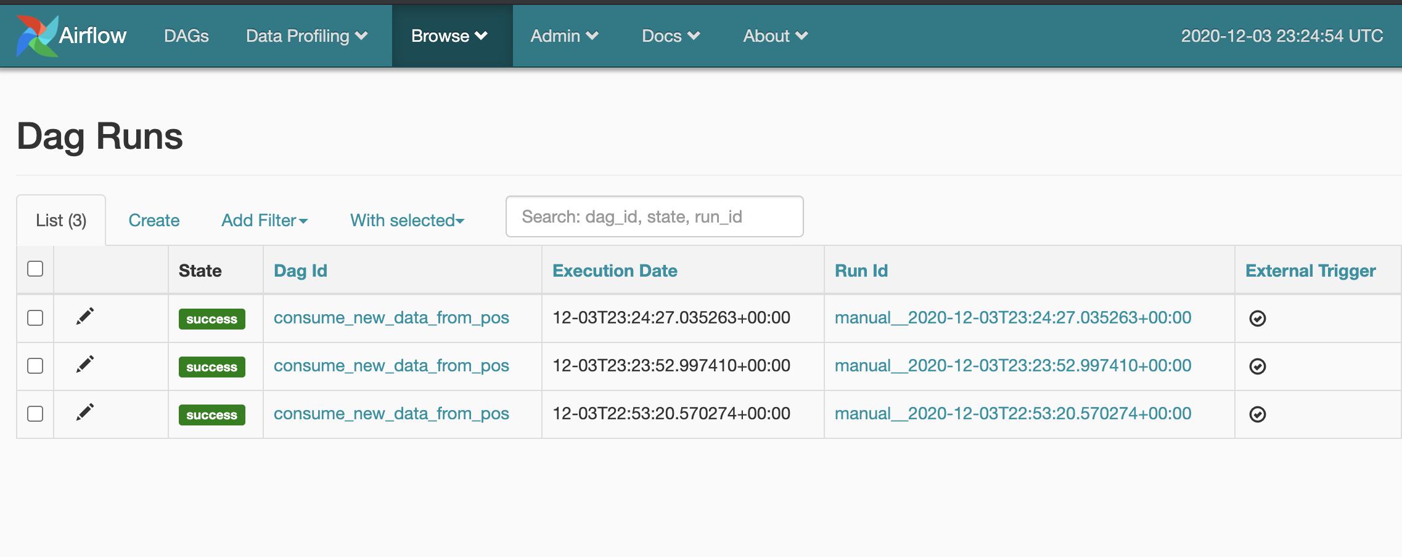
DAG Runs & Task Instances
http://localhost:8080/admin/dagrun/
83

Slide 84
Let’s change the schedule_interval
Set schedule_interval=“@daily” or “0 0 * * *”
Airflow support CRON expressions:
https://airflow.apache.org/docs/apache-airflow/stable/dag-run.html#cron-presets
@daily – just cron preset from Airflow
84

Slide 85
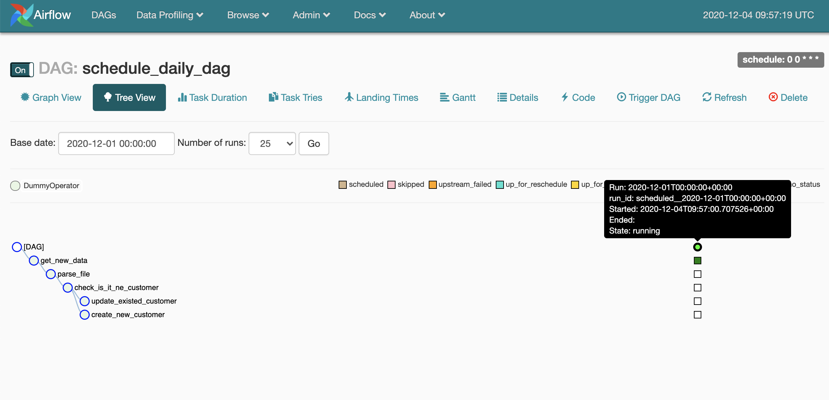
Let’s change the schedule_interval
85

Slide 86
Let’s change the schedule_interval
86

Slide 87
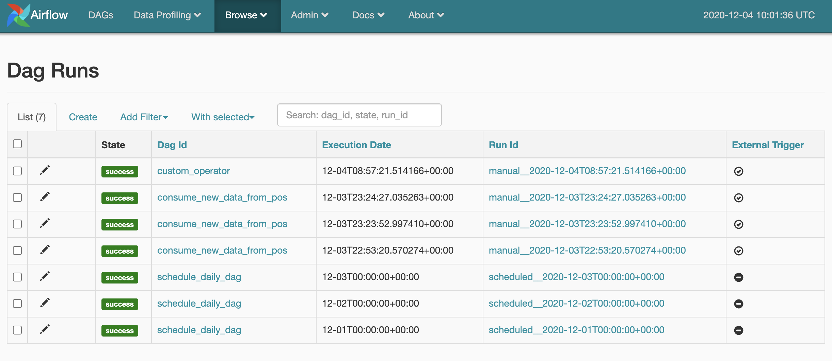
Let’s change the schedule_interval
CONFIDENTIAL | © 2019 EPAM Systems, Inc.
87
© 2020 EPAM Systems, Inc.

Slide 88
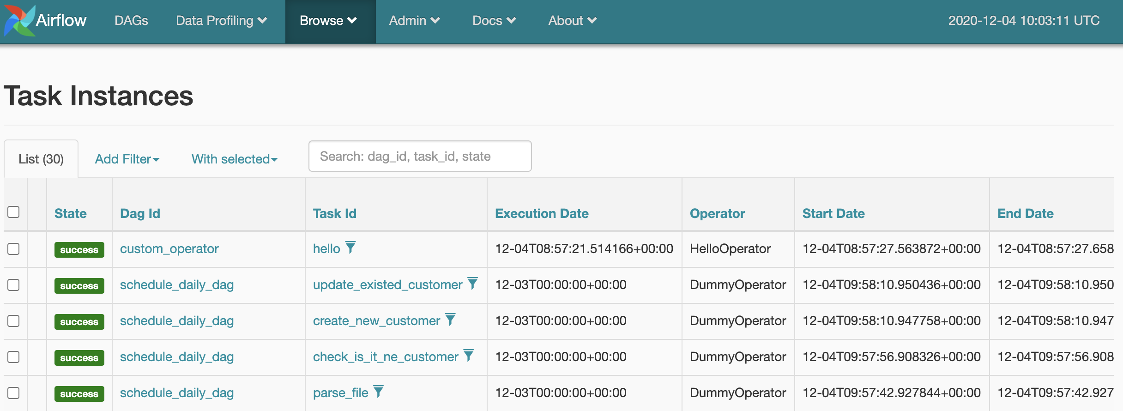
Let’s change the schedule_interval
CONFIDENTIAL | © 2019 EPAM Systems, Inc.
88
© 2020 EPAM Systems, Inc.

Slide 89
Execution_date, start_date & schedule_interval
Triggered Manually:
execution_date - triggering datetime (if DAG was triggered manually)
Scheduled:
execution_date - date for that we process the Data, not real start or task
start_date - date of data that we want to process
if start_date (2020, 12, 1) and schedule “@daily” “@hourly” 00:01
For the first time DAG will run on 2020, 12, 2, execution_date will be 2020, 12, 1,
but start_date of tasks will contain real execution datetime
CONFIDENTIAL | © 2019 EPAM Systems, Inc.
89
© 2020 EPAM Systems, Inc.

Slide 90
Let’s change the schedule_interval
Set schedule_interval=“@daily” or “0 0 * * *”
Airflow support CRON expressions:
https://airflow.apache.org/docs/apache-airflow/stable/dag-run.html#cron-presets
@daily – just cron preset from Airflow
90

Slide 91
Catch Up
from datetime import datetime from airflow import DAG from airflow.operators.dummy_operator import DummyOperator with DAG( dag_id="no_catch_up_schedule_daily_dag",
start_date=datetime(2020, 12, 1),
schedule_interval="0 0 * * *",
catchup=False ) as dag:
:param catchup: Perform scheduler catchup (or only run latest)?
Defaults to True
CONFIDENTIAL | © 2019 EPAM Systems, Inc.
91
© 2020 EPAM Systems, Inc.

Slide 92
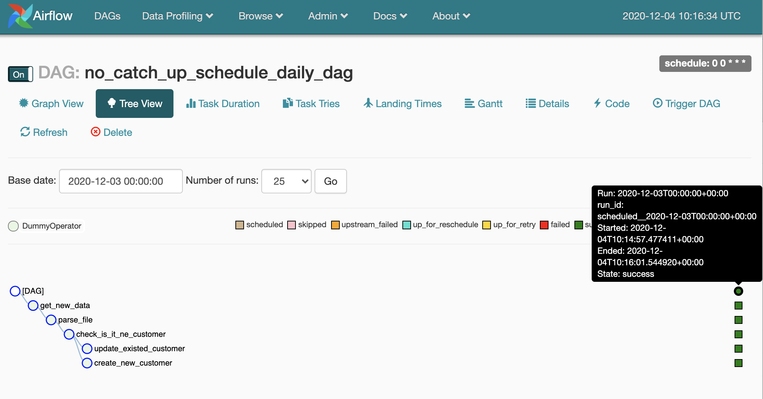
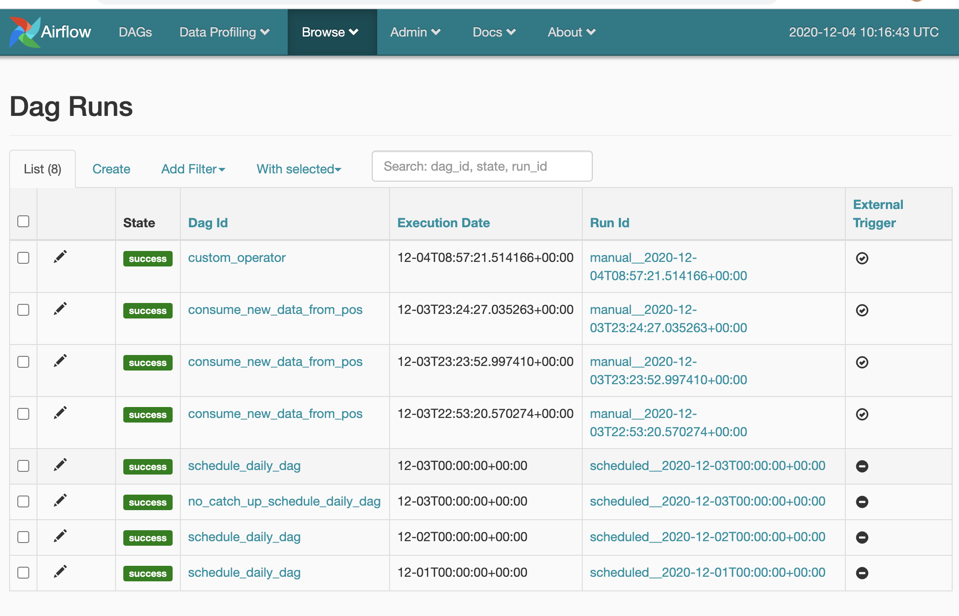
Catch Up
CONFIDENTIAL | © 2019 EPAM Systems, Inc.
92
© 2020 EPAM Systems, Inc.

Slide 93
Catch Up
CONFIDENTIAL | © 2019 EPAM Systems, Inc.
93
© 2020 EPAM Systems, Inc.

Slide 94
Parametrize tasks – Jinja2 Template
Task 1
Task 2
…
/${shop_id}/${current_date}/${hour}/${uuid_name}${pos_id}.xml
Get new data
Parse file
Let simplify it for study pipeline:
Use - FS, not HDFS and fix shop_id and file name data.json :
../shop123/{{ current_date }}/${hour}/data.json
{‘param_name’: value}
CONFIDENTIAL | © 2019 EPAM Systems, Inc.
94
© 2020 EPAM Systems, Inc.

Slide 95
Parametrize tasks – Jinja2 Template
Get new data – Sensor that wait for the file,
to avoid failed (‘parse_file’) task
Task 1
Task 2
…
Get new data
Parse file
from airflow.contrib.sensors.file_sensor import FileSensor
from airflow.operators.dummy_operator import DummyOperator
95

Slide 96
Parametrize tasks – Jinja2 Template
Get new data – Sensor that wait for the file,
to avoid failed (‘parse_file’) task
Task 1
Task 2
…
Get new data
Parse file
from airflow.contrib.sensors.file_sensor import FileSensor
from airflow.operators.dummy_operator import DummyOperator
FileSensor expect filepath arg with path to poke
96

Slide 97
Parametrize tasks – Jinja2 Template
from datetime import datetime from airflow import DAG from airflow.operators.dummy_operator import DummyOperator from airflow.contrib.sensors.file_sensor import FileSensor with DAG( dag_id="consume_new_data_from_pos_read_and_parse", start_date=datetime(2020, 12, 1), schedule_interval="0 * * * *" ) as dag: get_new_data = FileSensor(task_id="get_new_data", filepath="../shop123/${current_date}/${hour}/data.json")
${current_date} & ${hour} – we need somehow send dynamic variables inside it
97

Slide 98
Parametrize tasks – Jinja2 Template
Use Jinja2 Templates!
https://airflow.apache.org/docs/apache-airflow/stable/concepts.html#jinja-templating
Available macros: https://airflow.apache.org/docs/apache-airflow/stable/macros-ref.html#macros-reference

Slide 99
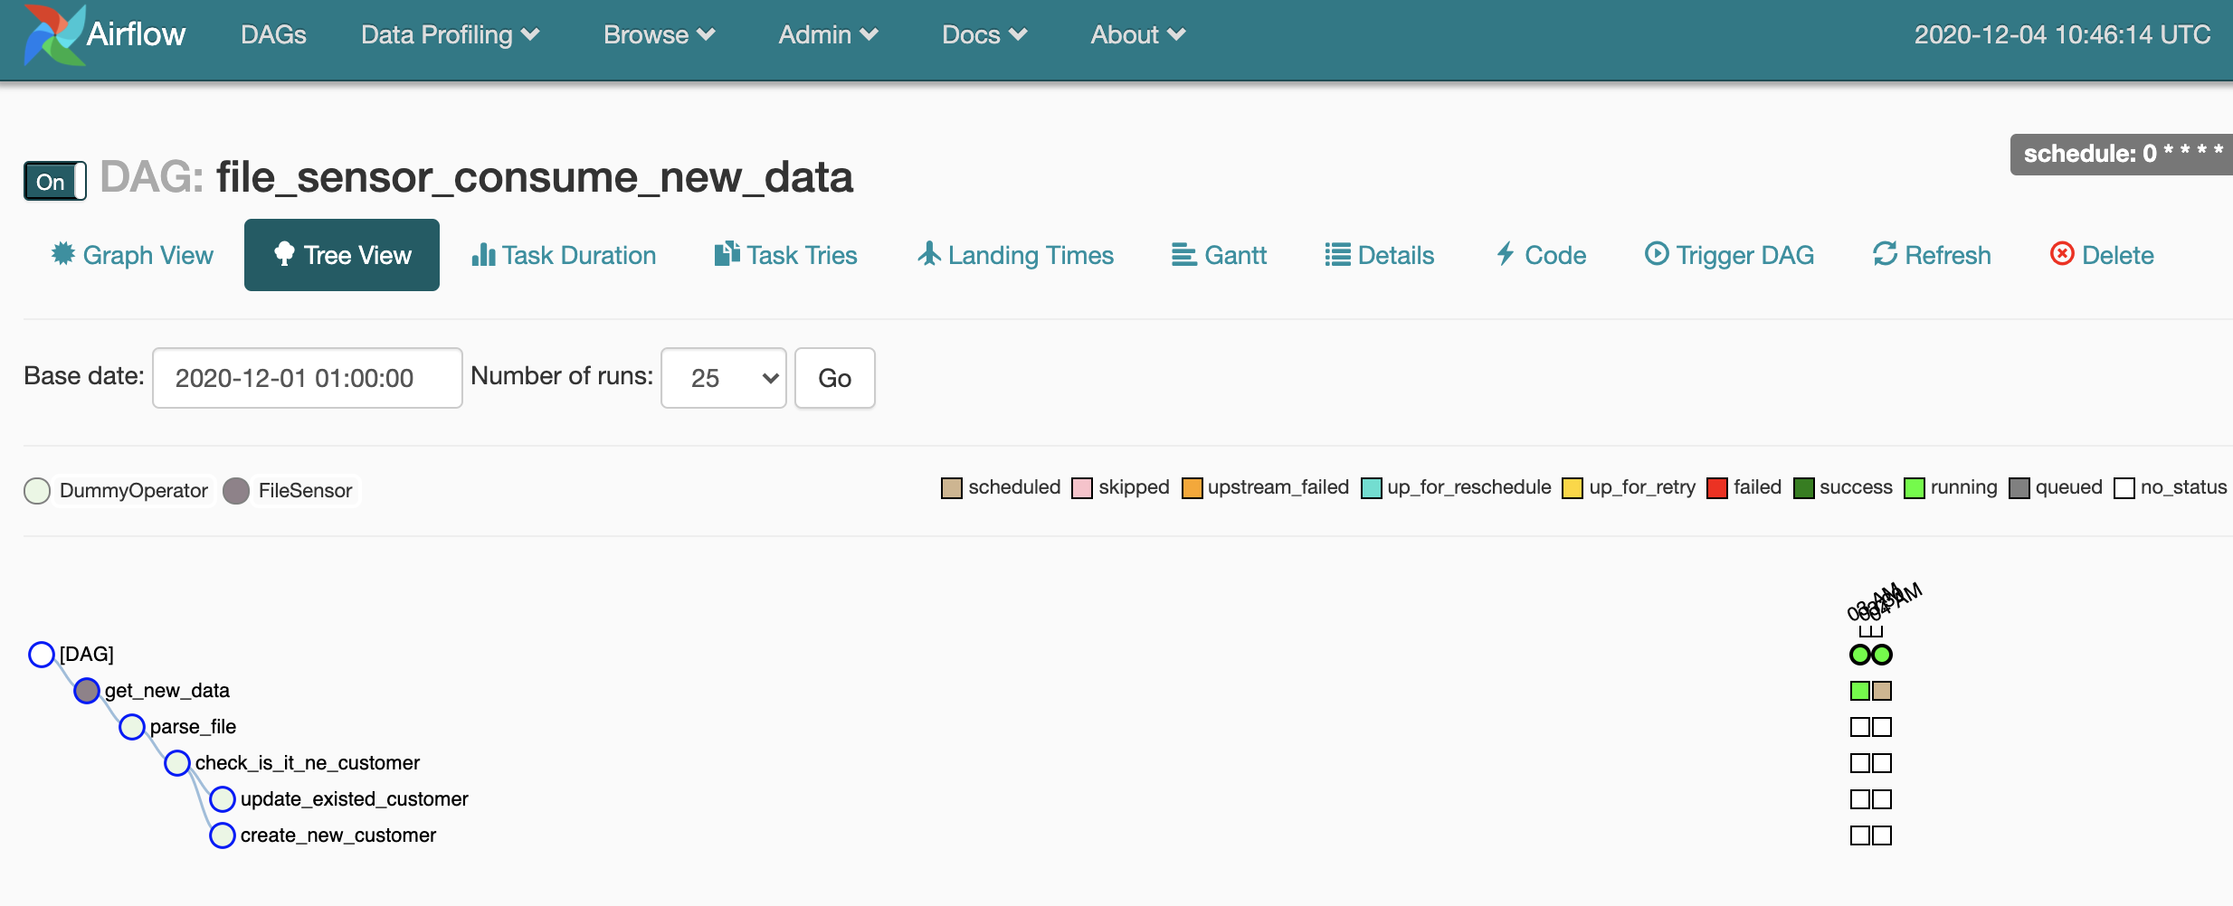
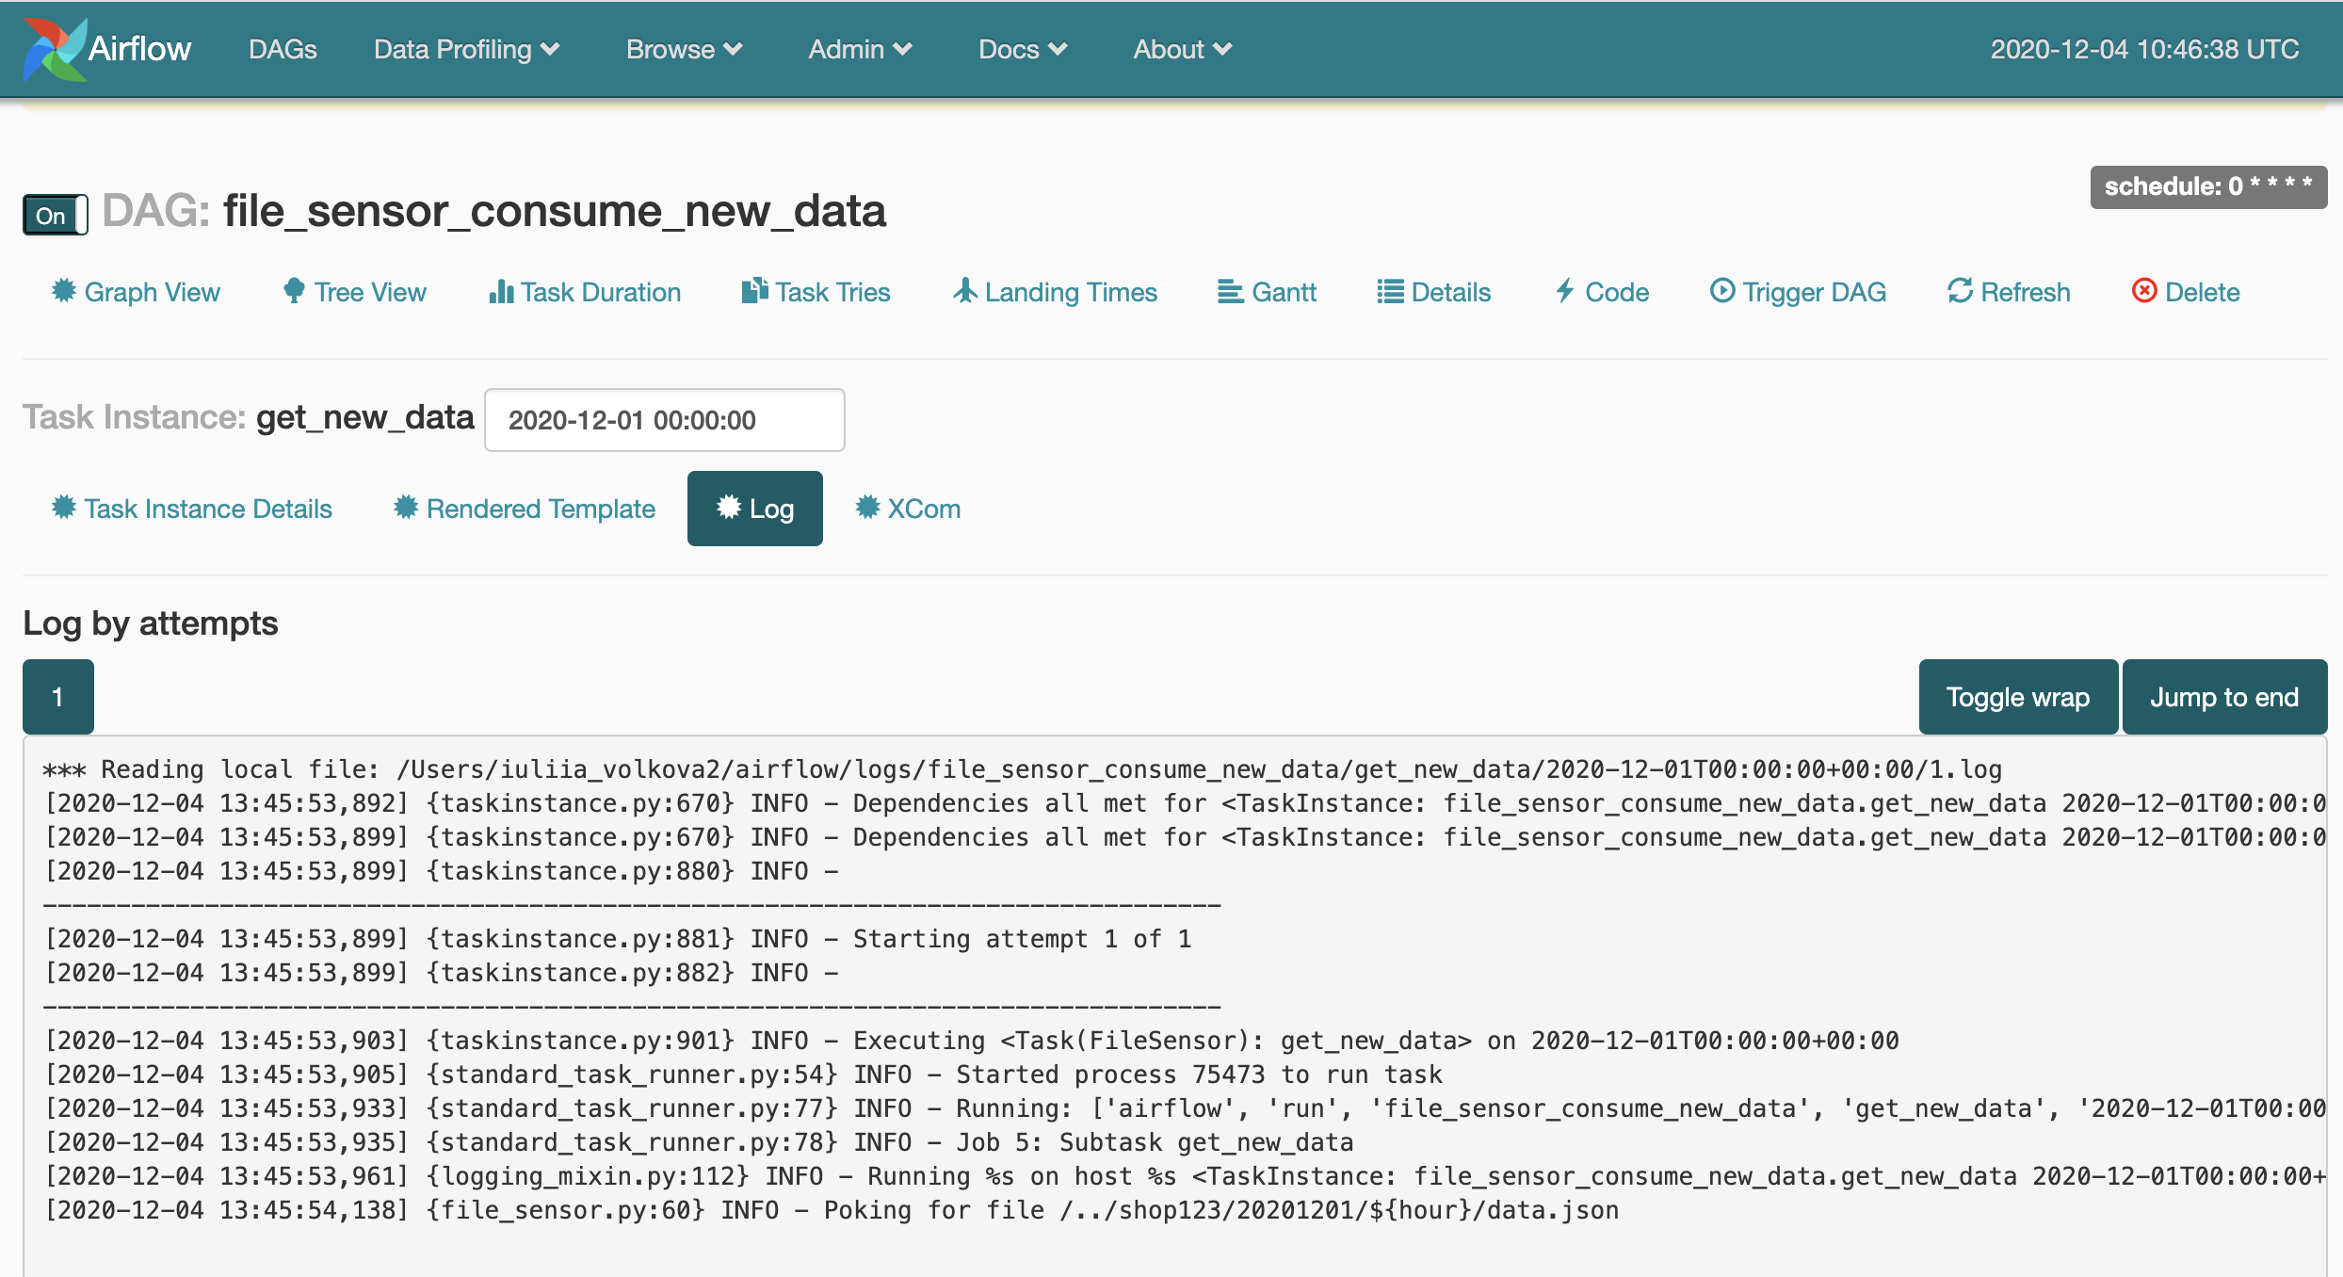
Parametrize tasks – Jinja2 Template

Slide 100
Last questions of Day 1
UI view changes (Operators colorizing)
Statuses - what are they mean?
What to do with hours?

Slide 101
Statuses
Sensors status

Slide 102
Statuses
mode=``{ poke | reschedule }``
Task is running non-stop on worker
Task re-schedule
(free worker cpu, free pool to other tasks)
Let’s try it & knows that to do with hours in the Day2
CONFIDENTIAL | © 2019 EPAM Systems, Inc.
© 2020 EPAM Systems, Inc.

Slide 103
The end of the Day 1

Slide 104
Homework
Check Apache Airflow docs web-site https://airflow.apache.org/docs/stable/start.html#quick-start
Do apache airflow Quick install (see links on the slides) & copy lecture DAGs in DAG folder – unpause them and see different behaviour
Run through Apache Aiflow source code & invistigare Dag, Task and Base Operator classes
Lecture DAGs:
https://github.com/xnuinside/airflow_lectures
Clone Airflow in Docker Compose with Celery:
https://github.com/xnuinside/airflow_in_docker_compose
Check that components are in docker-compose and needed to be defined to run with CeleryExecutor & try to up & run.
CONFIDENTIAL | © 2020 EPAM Systems, Inc.

